Slide 1
Lico: A Lightweight Access Control Model for Inter-Networking Linkages
Lico: A Lightweight Access Control Model for Inter-Networking Linkages
MIDHUN P
Class no: 37 S7 BTECH CSE

Slide 2
CONTENTS
Lico: A Lightweight Access Control Model for Inter-Networking Linkages
Introduction
Problem Formulation
Access Control Graph
Access Control Model
Proposed Authorizing Rules

Slide 3
CONTENTS
Lico: A Lightweight Access Control Model for Inter-Networking Linkages
Proposed Algorithms
Examples
Conclusion
References

Slide 4
INTRODUCTION
Lico: A Lightweight Access Control Model for Inter-Networking Linkages
Access control is crucial
Prevents unauthorized access
Conventional access control models – DAC
Accessor access objects based on Privilage
Three tuple {a,o,p}
An accessor can also be assigned to a role

Slide 5
INTRODUCTION(contd..)
Lico: A Lightweight Access Control Model for Inter-Networking Linkages
The privileges are bind to the roles
e.g. - faculty members, department heads
Indirect context
Lead to unauthorized extension of A’s privileges
A’s privilege for o is p1
A can invoke B to gain privilege for o to p2

Slide 6
INTRODUCTION(contd..)
Lico: A Lightweight Access Control Model for Inter-Networking Linkages
Inter-invoking
When interactions among processes are frequent
e.g., Shopping application + transaction application
These different processes have different privileges
e.g., the transaction application
payment account and location

Slide 7
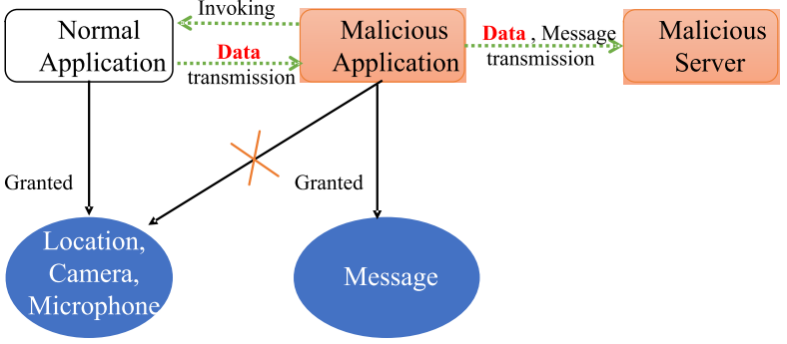
INTRODUCTION(contd..)
Lico: A Lightweight Access Control Model for Inter-Networking Linkages
Process A can directly access location information
Imagine process B is invoking A
Result ?
Courtesy : https://ieeexplore.ieee.org/document/8466580

Slide 8
PROBLEM FORMULATION
Lico: A Lightweight Access Control Model for Inter-Networking Linkages
Security Breach - the biggest issue
It can occur not only during process invoking
But also in OSNs
Tecent QQ
If A his QQ space public to say users B and C
Then users B and C may obtain additional information of another user

Slide 9
PROBLEM FORMULATION
Lico: A Lightweight Access Control Model for Inter-Networking Linkages
Access Control Graph
Graph model for access control
It can visualize the inter-relation among accessors

Slide 10
ACCESS CONTROL GRAPH
Lico: A Lightweight Access Control Model for Inter-Networking Linkages
Graph consists of vertexes and directed edges
Two types of vertexes
Accessors (black point) & Objects (white triangles)
Two types of directed edges
Accessor to accessor - invoking relations
Accessor to an object - accessing relations

Slide 11
ACCESS CONTROL GRAPH
Lico: A Lightweight Access Control Model for Inter-Networking Linkages
We can state ACG formally as follows:
ACG ::= < V , E > ;
V ::= Vacc ∪ Vobj ;
E = Einv ∪ Eacc;
Einv ::= <Vfrom, Vto> ,
(Vfrom ∈ Vacc, Vto ∈ Vacc)
Eacc ::= <Vfrom, Vto>,
(Vfrom ∈ Vacc, Vto ∈ Vobj)

Slide 12
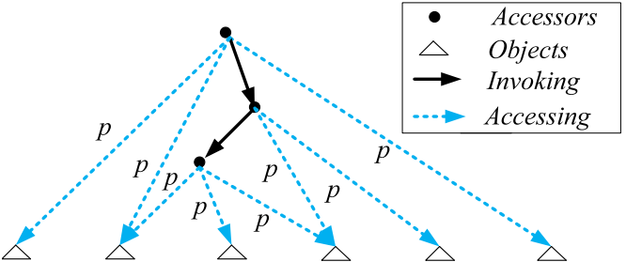
ACCESS CONTROL GRAPH
Lico: A Lightweight Access Control Model for Inter-Networking Linkages
Courtesy : https://ieeexplore.ieee.org/document/8466580

Slide 13
ACCESS CONTROL MODEL
Lico: A Lightweight Access Control Model for Inter-Networking Linkages
A simple ACG
Processes that can access resources
Direct and indirect means to access
Detect privilege collisions due to indirect paths
ACG contain following
1) ACG ::= <V, E>,
V is a set of vertexes and E is a set of edges.
2) V = VAcc ∪ VObj,
Vacc is a set of accessors and Vobj is a set of objects.

Slide 14
ACCESS CONTROL MODEL
Lico: A Lightweight Access Control Model for Inter-Networking Linkages
3) E = Einv ∪ Eacc,
Einv = set of invoking edges & Eacc = accessing edges.
4) EInv ::= <Vfrom, Vto>,
Vfrom ∈ Vacc, Vto ∈ Vacc.
5) Eacc ::= <Vfrom, Vto>,
Pi, Vfrom ∈ VAcc, Vto ∈ VObj, P ∈ Pri.
6) ∀e ∈ Eacc, e = <from, to, p>
from ∈ VAcc, to ∈ VObj,
p = [p1, p2, . . . , pn] ∈ {0, 1} n ,
n = |Pri|

Slide 15
ACCESS CONTROL MODEL
Lico: A Lightweight Access Control Model for Inter-Networking Linkages
7) ∀e ∈ Einv, e = <from, to >
from ∈ VAcc, to ∈ VAcc
8) Pri is a set of privileges
Pri ::= <pri1, pri2, . . . , prin>
|Pri| = n. E.g., Pri ::= <read,write, update>
9) ∀e ∈ Eacc, if pi = 1,
accessor e.from can access object e.to with prii ∈ Pri

Slide 16
ACCESS CONTROL MODEL
Lico: A Lightweight Access Control Model for Inter-Networking Linkages
Definition 1 :
An accessor -> accessors (direct or indirect)
Closure process Clsa : a ∈ VAcc → A ⊂ Vacc
Definition 2:
An accessor -> Objects (direct)
Closure function Clso : a ∈ VAcc → O ⊂ Vobj
Definition 3:
An accessor -> Objects (direct or indirect)
Closure function Clsao : a ∈ VAcc → O ⊂ VObj

Slide 17
ACCESS CONTROL MODEL
Lico: A Lightweight Access Control Model for Inter-Networking Linkages
Definition 4 :
Collision or not ?
HD : p1 ∈ {0, 1} n × p2 ∈ {0, 1} n → n ∈ Z
Definition 5 : (Privilege collisions)
Clla : a ∈ VAcc → n ∈ Z
∀a ∈ VAcc,
if Clla(a ∈ VAcc) != 0 or Clsao(a) ∩ Clso(a) != ∅,
privacy breach due to inter-networking linkages.

Slide 18
ACCESS CONTROL MODEL
Lico: A Lightweight Access Control Model for Inter-Networking Linkages
Definition 6 : (Privilege collision function)
Pric : p1 ∈ {0, 1} n × p2 ∈ {0, 1} n → b ∈ {0, 1}
b=0 if HD (p1, p2) = 0 (collision occurs)
Else b=1
Definition 7 : (Pairwise Privilege collision fn)
Pri’c : p1 ∈ Pri× p2 ∈ Pri → b ∈ {0, 1}
b=0 if HD (p1, p2) = 0 (collision occurs)
Else b=1

Slide 19
ACCESS CONTROL MODEL
Lico: A Lightweight Access Control Model for Inter-Networking Linkages
Definition 8 :
Array maps to privilege process
A2PSet : p ∈ {0, 1} n → pri1, pri2, . . . .
prin ∈ Pri
n = |Pri|
Definition 9 : (Privilege collision by array function)
A2C : p1 ∈ {0, 1} n × p2 ∈ {0, 1} n → b ∈ {0, 1}
b = 1, then no privilege collision occurs

Slide 20
PROPOSED AUTHORIZING RULES
Lico: A Lightweight Access Control Model for Inter-Networking Linkages
Rule I :
Privilege is non-increasing for an invoking edge
e1 = invoked accessor
e2 = invoking accessor
e1.pri <= e2.pri

Slide 21
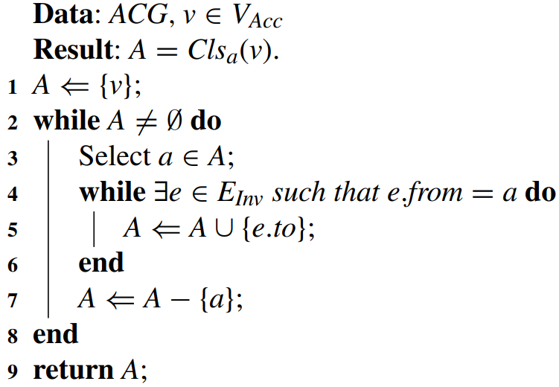
PROPOSED ALGORITHMS
Lico: A Lightweight Access Control Model for Inter-Networking Linkages
Algorithm 1
Accessor -> accessors in ACG

Slide 22
PROPOSED ALGORITHMS
Lico: A Lightweight Access Control Model for Inter-Networking Linkages
Algorithm 2
Accessor -> Object in ACG
Objects can be accessed in 2 ways
Direct or Indirect manner

Slide 23
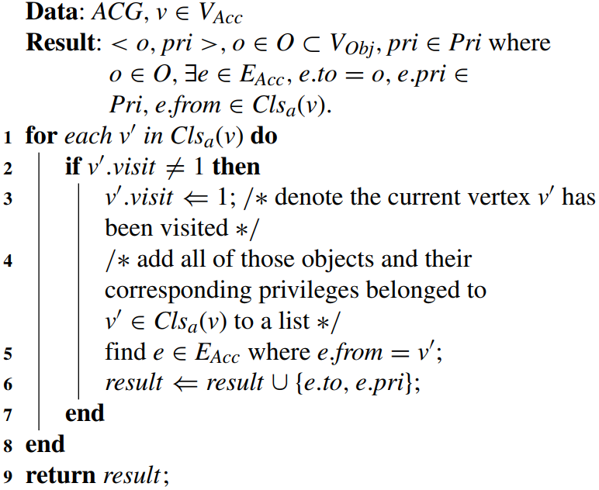
PROPOSED ALGORITHMS
Lico: A Lightweight Access Control Model for Inter-Networking Linkages

Slide 24
PROPOSED ALGORITHMS
Lico: A Lightweight Access Control Model for Inter-Networking Linkages
Algorithm 3
detect privilege collisions
Privilege collisions due to inter-process invoking

Slide 25
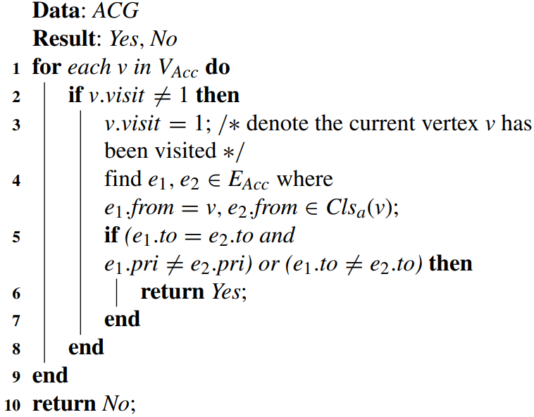
PROPOSED ALGORITHMS
Lico: A Lightweight Access Control Model for Inter-Networking Linkages

Slide 26
PROPOSED ALGORITHMS
Lico: A Lightweight Access Control Model for Inter-Networking Linkages
Algorithm 4
regulate privileges
access control module
regulate concrete accessing policies
avoid privilege breaches

Slide 27
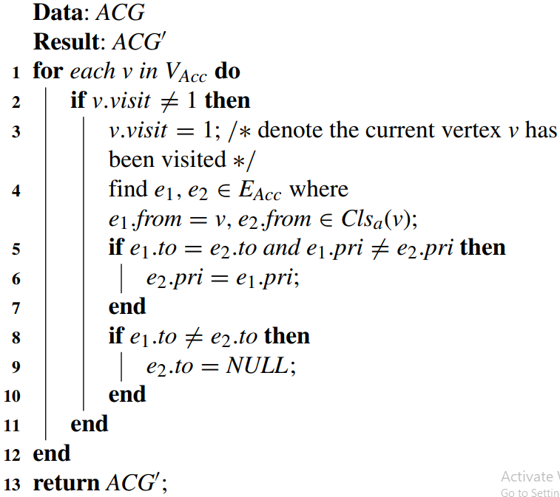
PROPOSED ALGORITHMS
Lico: A Lightweight Access Control Model for Inter-Networking Linkages

Slide 28
Examples
Lico: A Lightweight Access Control Model for Inter-Networking Linkages
Example 1
A invokes process B to access Obj O
The CU will detect privilege collisions
2 Decision
A expand its privileges to that of process B
A limit its privileges to that of process B
Take place in OS, Web Services

Slide 29
Example
Lico: A Lightweight Access Control Model for Inter-Networking Linkages
Example 1
A invokes process B to access Obj O
The CU will detect privilege collisions
2 Decision
A expand its privileges to that of process B
A limit its privileges to that of process B
Take place in OS, Web Services

Slide 30
CONCLUSION
Lico: A Lightweight Access Control Model for Inter-Networking Linkages
Proposed a lightweight graph-based model
access control among inter-networking processes
The cost is only O(n)
n = number of accessor vertexes

Slide 31
REFERENCES
Lico: A Lightweight Access Control Model for Inter-Networking Linkages
[1] R. S. Sandhu and P. Samarati, ‘‘Access control: Principle and practice,’’ IEEE Commun. Mag., vol. 32, no. 9, pp. 40–48, Sep. 1994.
[2] R. S. Sandhu, E. J. Coyne, H. L. Feinstein, and C. E. Youman, ‘‘Role-based access control models,’’ Computer, vol. 29, no. 2, pp. 38–47, 1996.
[3] B. W. Lampson, ‘‘Protection,’’ in Proc. 5th Princetion Symp. Inf. Sci. Syst., vol. 1, 1974, pp. 18–24.
[4] P. Samarati and S. C. de Vimercati, ‘‘Access control: Policies, models, and mechanism

Slide 32
REFERENCES
Lico: A Lightweight Access Control Model for Inter-Networking Linkages
[5] D. Ferraiolo, R. Sandhu, S. Gavrila, D. R. Kuhn, and R. Chandramouli, ‘‘Proposed NIST standard for role-based access control,’’ ACM Trans. Inf. Syst. Secur., vol. 4, no. 3, pp. 224–274, 2001.
[6] R. K. Thomas and R. S. Sandhu, ‘‘Task-based authorization controls (TBAC): A family of models for active and enterprise-oriented authorization management,’’ in Proc. 11th IFIP WG11.3 Conf. Database Secur., Lake Tahoe, NV, USA, 1997, pp. 166–181.

Slide 33
THANK YOU
Lico: A Lightweight Access Control Model for Inter-Networking Linkages

